Slide 1
QuePaxa: Escaping the Tyranny of Timeouts in Consensus
Pasindu Tennage* EPFL
Cristina Basescu* EPFL & Digital Asset
Eleftherios Kokoris Kogias ISTA & Mysten Labs
Ewa Syta Trinity College
Philipp Jovanovic UCL
Vero Galiñanes EPFL
Bryan Ford EPFL
Notes:
Hello Everyone
I am Pasindu, and I will present our work QuePaxa: escaping the tyranny of timeout in consensus
This work was done jointly with Cristina, Elefteris, Ewa, Phillip, Vero and my advisor Bryan Ford

Slide 2
Consensus and Replicated State Machine
State
State
State
State
C1
C2
C3
C4
C5
State
C1
C2
C3
C4
C5
State
C1
C2
C3
C4
C5
Notes:
Suppose 3 replicas want to replicate state in a strongly consistent manner
They use consensus to have a totally ordered log
Even if a minority of replicas fail, replicas maintain consistency

Slide 3
Consensus and Replicated State Machine
Notes:
Consensus has been studied over 4 decades
And also deployed in real world systems

Slide 4
RoadMap
Introduction to consensus
Tyranny of timeouts
Parallels of QuePaxa and hedging
QuePaxa algorithm
Evaluation
Notes:
Having discussed the domain of our presentation
We first discuss problems we call “the tyranny of timeouts” in existing leader based consensus protocols
And then we briefly discuss hedging, and its relevance to QuePaxa
We then present our protocol and the experiment evaluation

Slide 5
Tyranny of Timeout Problems in Consensus
Timeout based view change
Timeout based view change
Conservative timeouts
Manually configured timeouts
Notes:
We identify 3 problems in the existing consensus protocols because they use timeouts for liveness
Timeout based view change
Conservative timeouts
And manually configured timeouts
we refer these problems as tyrannies of timeouts
First let us look at timeout based view change problem

Slide 6
Timeout based view change [Multi-Paxos]
Commit
Commit
Commit
Commit
R1
R2
Propose
Accept
Propose
Accept
Propose
Accept
Propose
Accept
R3
R4
View 1
As long as the network is synchronous, the leader will keep committing new requests
Notes:
Assume a 4 replica configuration with R1 as the leader
All replicas are in the view 1
Under good network conditions the leader replica R1 sends a propose message, and
Other replicas accept, and upon receiving a majority accepts The leader commits
As long as the network conditions are synchronous, the leader will keep proposing and
Committing new commands

Slide 7
Timeout based view change [Multi-Paxos]
Commit
R1
Prepare
Propose
R2
Accept
Promise
Propose
Accept
R3
R4
View Change
View 1
View 2
No new commands are committed during view change
Liveness depends on partial synchronous network conditions
Notes:
Now let us see what goes wrong in leader based protocols
The leader R1 keeps proposing new commands in view 1
Due to a transient network problem, the the leader replica becomes unreachable for other replicas
Hence other replicas timeout
Then the replicas go to view 2, and replica 2 starts a leader election protocol
This is called view change
During the view change no new commands are committed
We see that Leader based protocols need timeout for recovery
Hence, liveness depends on partial synchronous network conditions, which is problematic

Slide 8
Tyranny of Timeout Problems in Consensus
Timeout based view change
Conservative timeouts
Conservative timeouts
Manually configured timeouts
Notes:
Next, let us look at conservative timeout problem

Slide 9
Choosing Timeouts in leader based protocols
Low Timeout
High Timeout
High Timeout
Timeout
Notes:
its difficult to choose the ideal timeout, because it depends on many unpredictable factors
Since we cannot realistically get it perfectly, we have to weigh the risks of choosing the timeout too high or too low.
Let us see what happens when you pick a timeout too high

Slide 10
Timeout based view change [Multi-Paxos]
Commit
R1
Prepare
Propose
R2
Accept
Promise
Propose
Accept
R3
R4
View Change
View 1
View 2
High Recovery Time
High timeouts result in high recovery time
Notes:
Let us consider our previous example
When the timeout is high, replica 2,3, and 4 wait a longer period before initiating a view change
This results in high recovery time, which is not good for performance

Slide 11
Choosing Timeouts in leader based protocols
Low Timeout
Low Timeout
High Timeout
High Timeout
High Timeout
Timeout
High Recovery Time
Notes:
Let us see what happens when you pick the timeout too low

Slide 12
Liveness loss with low timeouts
R1
Propose
R2
Prepare
…
R3
Prepare
R4
View 1
View 2
View 3
View 4
No commands are committed when the timeout is low
Notes:
In view 1, R1 is the elected leader
If R1 was not failed but it is just slower than the timeout permits, then these timeouts cause other replicas to ignore R1s messages
Hence replicas move to view 2 and R2 starts a leader election
Low timeout cause other replicas to ignore R2s prepare and they move to view 3
This process can go forever without any leader making progress
Nothing is committed during the entire execution

Slide 13
Choosing Timeouts in leader based protocols
Low Timeout
High Timeout
High Timeout
High Timeout
Timeout
Liveness Loss
High Recovery Time
Both choices of timeouts have negative consequences
Notes:
Hence, we conclude, that leader based protocols have to sacrifice recovery time if they select a high timeout. If they select a low timeout, they risk sacrificing liveness.

Slide 14
Tyranny of Timeout Problems in Consensus
Timeout based view change
Conservative timeouts
Manually configured timeouts
Manually configured timeouts
Notes:
Finally, the third tyranny

Slide 15
Manual configuration of timeouts
Stuck with a live but slow leader replica
Do not consider dynamic network state for leader election
Manual timeouts are sub optimal
Notes:
Manual configuration of timeouts
When the timeouts are selected manually, the protocol can stuck with a live but slow leader replica
Also manual timeouts do not consider the dynamic network state

Slide 16
Are timeouts necessary for progress?
Can we eliminate the impact of timeout for liveness?
Notes:
Having discussed the 3 tyranny of timeouts problems, in this research we ask,
Are timeouts necessary for progress?
Also we ask Can we eliminate the impact of timeout for liveness?

Slide 17
Do asynchronous protocols solve this problem?
Asynchronous protocols do not depend on timeout for progress
Use randomization to alleviate the FLP impossibility
Message complexity
In general asynchronous protocols have O(n²) / O(n³) complexity in the normal case
In contrast, partially synchronous protocols have O(n)
Less efficient than leader-based protocols
Hence rarely deployed
Asynchronous protocols are slow and rarely deployed
Notes:
There are asynchronous protocols, whose liveness do not depend on timeouts.
So do they solve our problem?
Existing asynchronous protocols have quadratic or cubic complexity even in the normal case, hence inefficient than leader based protocols
Hence they are rarely deployed

Slide 18
An alternative approach?
Leader 1
Commit
R1
Propose
Accept
Leader 2
Commit
R2
Propose
Accept
Accept
Leader 3
Propose
R3
Commit
R4
Leader 4
No view change
No view change
Can we change leaders without view changes if the current leader is sub optimal?
Notes:
In this research, we ask whether we can have an alternative approach to consensus, such that the choice of timeout does not affect the lieveness
Our envisioned approach is as follows
Rather than a fixed leader, there is a sequence of leaders
Under normal conditions, leader 1 proposes, and others accept
If leader 1 is slow, then without a view change, leader 2 starts to propose after a delay
If both leader 1 and 2 are slow, then leader 3 starts to propose

Slide 19
What if multiple leaders could cooperate instead of interfere?
Leader 1
commit
R1
Propose
Leader 2
R2
R3
Leader 3
R4
Leader 4
Round 1
Can we support multiple proposers to be non destructive?
Notes:
Our envisioned approach has a challenge, what if multiple proposers concurrently propose?
Leader 1 initially propose, and assuming the leader 1 is slow, leader 2 proposes concurrently.
Can we support multiple proposers to be non destructive?

Slide 20
RoadMap
Introduction to consensus
Tyranny of timeouts
Parallels of QuePaxa and hedging
QuePaxa algorithm
Evaluation
Notes:
Our envisioned consensus protocol have some parallels with a technique called hedging, so let us briefly look at hedging

Slide 21
Hedging
Hedging is a way to curb latency variability
Key idea: issue the same request to multiple replicas and use the results from whichever replica responds first
Multiple responses
do not interfere with each other
Server
Store 1
Store 2
Store 3
Can we apply hedging to consensus so that multiple proposers don’t interfere?
Notes:
Hedging, is a technique to curb the latency variability by issuing parallel requests
Assume a 2 tier architecture with 1 server in tier 1 and 3 stores in tier 2
To process a request. Server needs to get a response from at least 1 store
The server sends parallel requests to multiple servers, assuming that at least one of them will respond quickly
Some stores responds to the request
When server receives multiple responses they do not interfere with each other, and this is the key idea of hedging
Can apply hedging to consensus such that the concurrent proposals do not destructively interfere?

Slide 22
RoadMap
Introduction to consensus
Tyranny of timeouts
Parallels of QuePaxa and hedging
QuePaxa algorithm
Evaluation
Notes:
WIth that we are ready to explore QuePaxa

Slide 23
QuePaxa Contributions
A consensus protocol that eliminates the tyranny of timeouts for liveness
First consensus protocol to support hedging in consensus
A novel consensus protocol that
Under normal network conditions as good as Multi-Paxos /Raft
Under adversarial network conditions, provides liveness
Notes:
QuePaxa makes the following contributions
A consensus protocol that eliminates the “tyranny of timeouts” problem for liveness
First consensus protocol to support hedging in consensus
A novel consensus protocol that is as good as the existing leader based protocols under normal case network conditions while providing robustness against adversarial network conditions

Slide 24
QuePaxa RoadMap
Operation Overview
Abstract QuePaxa – a simplified version
Safety and liveness of abstract QuePaxa
Concrete QuePaxa overview
Notes:
This is the mini road map for quepaxa
We first give you an operational overview of QuePaxa
Second, we discuss abstract quepaxa, which is a simplified version of quepaxa for ease of understanding, and its safety and liveness properties
And then we show how we convert this abstract quepaxa to the concrete quepaxa protocol

Slide 25
QuePaxa Architecture
Submitter
Submitter
Client Requests
Replica
Replica
Replica
Proposer
Proposer
Proposer
Recorder
Recorder
Recorder
Notes:
In QuePaxa, each replica plays two roles, Proposers and Recorders
The recorders are passive memory units, that store the state
The proposers are active and drive the consensus by sending RPCs to Recorders
Submitters submit commands to proposers

Slide 26
QuePaxa Log Structure
Round 1
Round 2
Slot 1
P1
P2
P3
P4
Slot 2
Slot 3
Notes:
Like Paxos, QuePaxa runs the protocol for each slot where a slot is a consensus instance
Each slot contains multiple rounds and within a round there are 4 phases

Slide 27
QuePaxa Protocol Diagram
Fast Path Decision
Slow Path Decision
Phase 0
Phase 1-3
Learn Majority Proposals
Information Propagation
Proposer 1
Recorder 1
Recorder 2
Recorder 3
Proposer 2
QuePaxa has a fast path decision and a slow path decision
Notes:
In given round, QuePaxa has four phases
In phase 0, the proposers flip a coin and assign a priority to their proposals, and send the proposal to all the recorders
Then in phase 1 to 3, each proposer propagates the learnt values from the recorders
The proposers decide in two occasions: (1) in the phase 0, if the network is synchronous, and only 1 proposer is proposing and (2) at the end of 2nd phase, with some probability

Slide 28
QuePaxa RoadMap
Operation Overview
Abstract QuePaxa - a simplified version
Safety and liveness of abstract QuePaxa
Concrete QuePaxa overview
Abstract QuePaxa is a simplified version of QuePaxa
Notes:
Having seen the architecture and the protocol overview, we now discuss the abstract QuePaxa protocol, which is a simplified version of QuePaxa, that is used for illustration purposes

Slide 29
Introducing threshold broadcast (tcast)
Divide the problem in to two parts
Handling replica failures
Handling asynchrony
First ignore asynchrony and focus on replica failures
Using tcast let us assume a synchronous lock step network
tcast (threshold synchronous broadcast): an abstraction which provides lock step synchrony to the consensus layer
Abstract QuePaxa
tcast
Asynchronous Network
Abstract QuePaxa assumes synchrony and solves the replica failure challenge
Notes:
Any asynchronous protocol has to solve 2 challenges : replica failures and network asynchrony
As a first step, let us assume that the network is synchronous and solve only the replica failure challenge first, the resulting protocol is called abstract quepaxa
We assume a primitive called threshold synchronous broadcast a novel network abstraction that provides lock step synchrony to consensus layer

Slide 30
Abstract QuePaxa Algorithm
Abstract QuePaxa is just a few lines of pseudocode!
Notes:
Abstract QuePaxa uses randomization to prioritize proposals
Abstract quepaxa uses 3 tcasts steps
the point here is just that it’s a conceptually simple protocol that I’ll explain in the next few slides

Slide 31
Proposals Bob knows to exist
Bob
Proposal Alice knows that all others know to exist
Propose B
Proposal Bob knows that all others know to exist
Proposal Charlie knows that all others know to exist
Propose A
tcast
Propose C
Alice
Charlie
Proposals Charlie knows to exist
Proposals Alice knows to exist
tcast property 1: each node learns a majority of proposals
tcast property 2: each node learns a proposal that all nodes know to exist
Nodes have no guarantee to learn the same sets! (no consensus yet)
Notes:
We said we rely on tcast to abstract away network asynchrony. Let us see what tcast gives us
Each node proposes a value, for example Alice proposes A, Bob proposes B, Charlie proposes C. And they use tcast to distribute the proposals and learn of other proposals.
The first property of tcast: each node learns a majority of proposals. For instance, Alice learns A and B, Bob learns A and B and Charlie learns B and C
The second property of tcast: each node learns a proposal that all nodes know to exist.
For example Alice, Bob and Charlie learn that all other nodes know of proposal B to exist.
In general, Tcast does not provide any guarantee that nodes learn the same sets (no consensus yet).

Slide 32
Towards consensus: approximating what others know
Sets from one tcast invocation are insufficient for consensus
Repeat: three tcast invocations, giving each node i sets with increasing guarantees
Key relationship for consensus: Existent_{i} ⊇ Common_{j} ⊇ Universal_{k}
An existent set: If Alice knows that a proposal exists, then it’s in her existent set
A common set: If Alice knows that all nodes know a proposal to exist, then it’s in Alice’s common set
A universal set: If Alice knows that all nodes know a proposal p to be common, then it’s in her universal set
Notes:
Sets from one tcast invocation are insufficient for consensus
Using multiple tcast calls, each node approximate what other nodes know about the sets
Therefore, We use three tcast calls to achieve the following: all nodes learn three sets: existent set, common set , universal set.
If Alice knows that a proposal exists, its in her existent set
If Alice knows that all nodes know a proposal to exist - it’s in Alice’s common set
If Alice knows that all nodes know a proposal to be common - it’s in Alice’s universal set
The key relationship that enables QuePaxa to reach consensus is this inclusion relationship. This means, any node’s universal set is included in any node’s common set, which is in turn included in any node’s existent set.

Slide 33
Existent_{i} ⊇ Common_{j} ⊇ Universal_{k}
Notes:
This is a visual depiction of the set relationship.
First each node form the existent set
Then the common set
And finally the universal set
Any node’s universal set, depicted in green, is a subset of any node’s common set, depicted in orange, which is a subset of any node’s existent set, depicted in blue.
The figure shows that the sets of each node are not guaranteed to be the same.
Still, even with this imperfect knowledge of different sets, nodes use the inclusion relationship to reach consensus, as we show next.

Slide 34
QuePaxa RoadMap
Operation Overview
Abstract QuePaxa
Safety and liveness of abstract QuePaxa
Concrete QuePaxa overview

Slide 35
Consensus: reaching a safe decision
Only possible decision in future is V’ = best(Common_{Bob}) = best(Existent_{Alice}) = V
best(Common_{Bob})
Bob doesn’t decide, proposes V’
propose
best(Existent_{Bob}) ≠
best(Universal_{Bob})
Three tcast rounds
V’ = best(Common_{Bob})
NO
best(Existent_{X}) =
best(Universal_{X})
Existent_{Alice} ⊇ Common_{Bob}⊇ Universal_{Alice}
Alice decides V
YES
best(Universal_{Alice})
best(Existent_{Alice}) = V =
decide
Notes:
Now let’s see how QuePaxa reaches a safe decision.
A node proposes a value and disseminates it in three tcast rounds.
The decision condition is that the best proposal in the existent set is also the best in the universal set.
Suppose Alice is lucky and her sets fulfil the decision condition. Then she decides on the best in her existent set, which equals the best in her universal set.
Assume Bob cannot decide.
Then Bob proposes in the next round its best proposal in the common set.
Let’s see why this is safe.
Value selected by Bob necessarily equals the value Alice (and any other user) might have decided.
Since all users that cannot decide do that, the only possible decisions going forward are on the value that Alice decided.
Therefore QuePaxa ensures safety.

Slide 36
Efficiency: How many rounds until consensus
Decision probability is ≥ ½ ⇒ in expectation two rounds until decision
Probability that Alice decides
Prob (best(Existent_{Alice}) = best(Universal_{Alice}))
Each set contains
> ½ of proposals
best
Notes:
Now let’s see how quickly nodes decide in expectation.
The probability that alice decided is that the best proposal in her existent set equals the best proposal in her universal set.
Here are the nodes sets.
Each set contains by construction more than a majority of proposals, as depicted.
And we want the best proposal to be in universal, as depicted.
The probability is at least one half in expectation. Therefore each node decides
In two rounds in expectation.

Slide 37
Abstract QuePaxa
🙂
Avoids timeout from liveness because the protocol is randomized
Robust against adversarial networks
O(n2) message complexity hence slow
Does not support hedging
🙂
😔
😔
Abstract QuePaxa is robust but inefficient
Notes:
To summarize the abstract QuePaxa algorithm
Abstract QuePaxa algorithm does not depend on timeout for liveness, and is also robust against adversarial network conditions
However, Abstract QuePaxa has quadratic message complexity and hence slow under normal case executions
Finally, Abstract QuePaxa does not support hedging, which was our main motivation for a new protocol

Slide 38
QuePaxa RoadMap
Operation Overview
Abstract QuePaxa
Safety and liveness of abstract QuePaxa
Concrete QuePaxa overview
Notes:
With that let us briefly look at how to convert the abstract QuePaxa to concrete QuePaxa protocol

Slide 39
From abstract to concrete QuePaxa
O(n) complexity in the normal case
Robust against asynchrony
Support hedging
Implementation ready (4368 LOC)
Abstract QuePaxa
Concrete QuePaxa
tcast
Interval Summary Register
Asynchronous Network
Asynchronous Network
Concrete QuePaxa has all we need!
Notes:
Abstract quepaxa assumes tcast and solves the reliability problem
In concrete QuePaxa, we Replace this tcast with proposer algorithm that uses a very simply atomic accesses to a new kind of atomic register that we call interval summary register
The concrete quepaxa has linear overhead, it is robust and supports hedging, and also implementation ready

Slide 40
QuePaxa Architecture
Submitter
Submitter
Client Requests
Replica
Replica
Replica
Proposer
Proposer
Proposer
Recorder
Recorder
Recorder
Notes:
To remind you the architecture of the concrete QuePaxa, each replica plays two roles; active proposers and passive recorders. Let us briefly see how these 2 components work

Slide 41
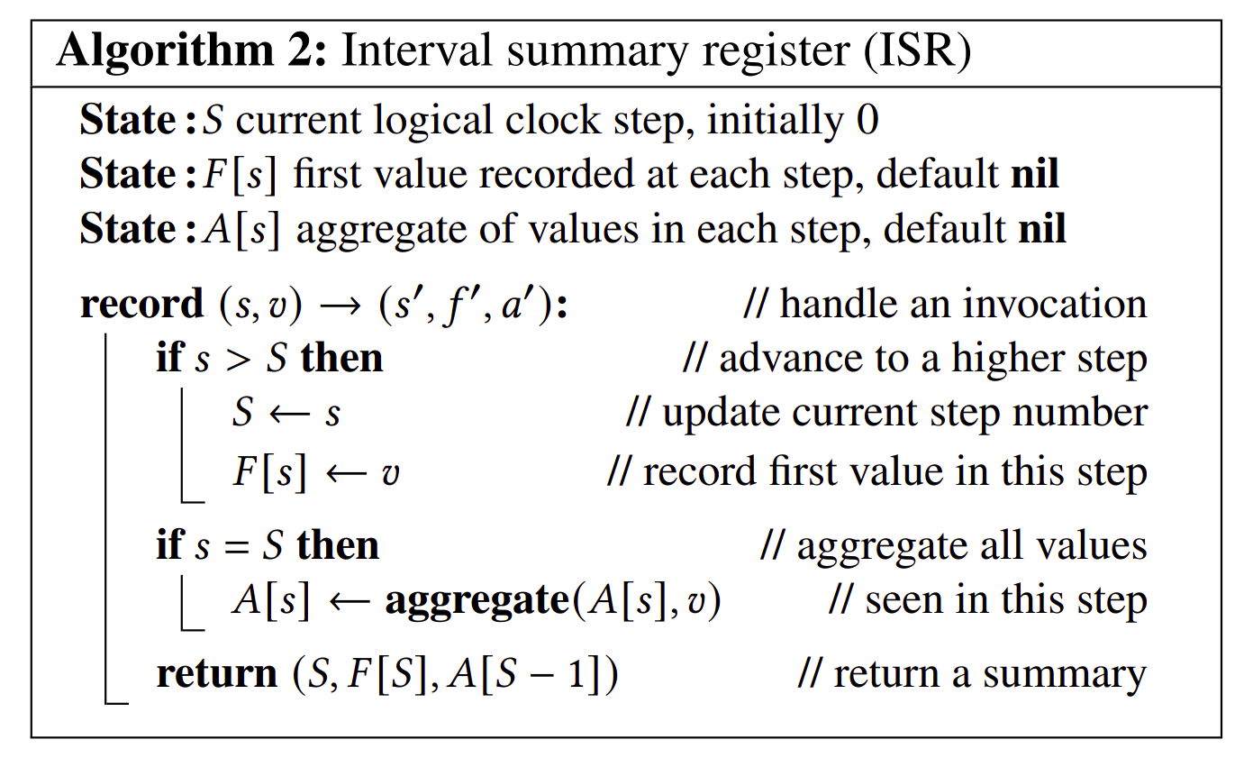
Concrete Recorder Protocol (ISR)
Simulates lock step synchrony using a threshold logical clock
For each step, records the the first value and the aggregate of the values submitted in the previous step
Constant space
QuePaxa Recorder is a constant space interval summary register
Notes:
Recorders implement what we call an Interval summary register.
An Interval summary register uses a threshold logical clock, or step counter, to handle network asynchrony
Our Interval summary register is constant space and records the summary of values submitted in the current and previous steps
Please see the paper for details

Slide 42
Proposer Code
QuePaxa proposer uses RPC in 4 phases to contact Recorders
Notes:
This is proposer code
Basically it invokes the Interval summary register in the recorders in 4 phases using RPC

Slide 43
Hedging in QuePaxa
Phase 0
Phase 1-3
Learn Majority Proposals
Information Mule
Proposer 1
Recorder 1
Recorder 2
Recorder 3
Proposer 2
QuePaxa supports hedging because multiple proposers do not cancel each other
Notes:
Finally, let us recap how QuePaxa builds a consensus scheme that allows hedging
In the phase 0 of a round, one or more proposers propose for the same slot
In phases 1-3, each proposer propagates the information recorded in the recorders
Even when more than 1 proposer is active, they do not interfere with each other
Hence QuePaxa supports hedging, because multiple proposers do not cancel each other

Slide 44
Other Contributions
Multi-Armed-Bandit based hedging sequence tuning for maximum performance
Optimizations for reducing leader bandwidth bottleneck for high performance
Notes:
We make tuning and performance optimizations in the paper, and please refer the paper for more details

Slide 45
RoadMap
Introduction to consensus
Tyranny of timeouts
Parallels of QuePaxa and hedging
QuePaxa algorithm
Evaluation
Notes:
Finally, let us look at the evaluation

Slide 46
Evaluation
Can QuePaxa guarantee liveness under any timeout?
Under normal case executions, how does QuePaxa compare with leader-based protocols?
Under adversarial conditions, does QuePaxa provide liveness?
Can QuePaxa converge to the best hedging-sequence? – please refer the paper
Notes:
In this evaluation we ask
Can QuePaxa guarantee liveness under any timeout?
Under normal case executions, how does QuePaxa compare with leader-based protocols?
Under adversarial conditions, does QuePaxa provide liveness?
Can QuePaxa converge to the best hedging-sequence?

Slide 47
Setup
LAN (N. Virginia)
WAN (Tokyo, Mumbai, Singapore, Ireland, and São Paulo)
Replicas: c4.4xlarge
16 virtual CPUs, 30 GB memory
Submitters: c4.2xlarge
8 virtual CPUs, 15 GB memory
Notes:
We experimented in AWS EC2 both in a local area network and a wide area network

Slide 48
Effect of Hedging in Quepaxa
Throughput
QuePaxa is live for any hedging delay
Notes:
This graph shows the impact of timeout for liveness
In the x axis we show the leader timeout for paxos and raft, and the hedging delay for QuePaxa. In the y axis we show the throughput
QuePaxa is live for any hedging delay
Multi paxos and raft are live only when the leader timeout is greater than the Round trip time
Hence, QuePaxa supports low hedging delays without sacrificing the liveness

Slide 49
Effect of Hedging in Quepaxa
Throughput
Bandwidth Cost
QuePaxa has an additional overhead only when hedging delay < RTT
Notes:
The second graph measures the overhead of QuePaxa when the hedging delay is less than the network round trip time
In the y axis we show the average number of steps per slot, that represents the additional bandwidth overhead
Only when the hedging delay is less than network round tirp, QuePaxa has additional overhead due to redundant proposals by concurrent proposers

Slide 50
Effect of Hedging in Quepaxa
Throughput
Bandwidth Cost
Recovery Time
QuePaxa has low recovery time
Notes:
The third graph shows the impact of timeout for recovery
In the y axis we show the recovery time
We see that QuePaxa has a low recovery time
In contrast, paxos and raft have significantly high recovery times

Slide 51
Normal case execution in a WAN (see paper for LAN)
QuePaxa performs comparable to Multi Paxos
Notes:
This graph compares the normal case performance of queapaxa in WAN against existing protocols
In the x axis we show the throughput and in the y axis we show the median latency
We see that Quepaxa performs comparably to multii-paxos

Slide 52
Performance under adversarial networks
QuePaxa is live under asynchrony
Notes:
This graph shows the throughput vs latency behavior of QuePaxa under adversarial network conditions
We see that QuePaxa remains live
In contrast, paxos and raft lose liveness

Slide 53
Conclusion
QuePaxa eliminates timeout from liveness guarantees and supports hedging
QuePaxa provides Multi-Paxos / Raft equivalent performance under normal case
QuePaxa is resilient to adversarial network conditions
https://github.com/dedis/quepaxa
Notes:
In conclusion
We presented QuePaxa, a novel randomized protocol that
Eliminates timeout from liveness guarantees and supports hedging
Provides Multi-Paxos equivalent performance under normal case
Is resilient to asynchronous network conditions

Slide 54
Supplementary

Slide 55
Hedging delay vs Timeout
Timeouts initiate failure-recovery processes that interfere with normal progress if triggered early
a premature Raft view change halts the prior leader’s progress.
Hedging initiates non-destructive concurrency:
launching a second QuePaxa proposer does not prevent the first from still completing the round.
QuePaxa hedging delays can be zero without losing liveness
but the cost is redundant messaging

Slide 56
tCast vs other Broadcast flavours
Best effort broadcast: If a correct process broadcasts a message m, then every correct process eventually delivers m.
Reliable broadcast: : If a message m is delivered by some correct process, then m is eventually delivered by every correct process.
Uniform reliable broadcast: If a message m is delivered by some process (whether correct or faulty), then m is eventually delivered by every correct process.
Byzantine consistent broadcast: delivered m is the same for all receivers.
Byzantine reliable broadcast: all correct parties deliver some request or none delivers any (Bracha’s broadcast)

Slide 57
tCast
tcast property 1: each node learns a majority of proposals
tcast property 2: each node learns a proposal that all nodes know to exist

Slide 58
QuePaxa vs Common Core
Common core allows all replicas to create a common core (n-f proposals), such that each node knows that there are n-f proposals known by everyone, however, no node exactly knows which n-f proposals are common. In the literature, common core is used in binary consensus.
In contrast, tcast-based QuePaxa allows nodes to not only create a common core but also pinpoint which n-f proposals are common. Nodes reach multi-valued consensus using the set relationship we mentioned.

Slide 59
Overhead of Multiple Proposers
Throughput
Bandwidth Cost

Slide 60
Normal Case LAN performance

Slide 61
FLP impossibility and QuePaxa
QuePaxa uses randomization to alleviate FLP
However, when the network is synchronous, QuePaxa uses that to provide 1 round trip fast path
QuePaxa uses private randomness, and that enables hedging

Slide 62
Fast path of 1 RTT in concrete QuePaxa
How does concrete quePaxa reduce the fast path to just 1 RTT, given that one tcast is several round trips, and one abstract QuePaxa is two tcasts?
The first tcast of abstract QuePaxa corresponds to a spread phase in concrete QuePaxa in 1 RTT: Each proposer records its proposal at a recorder. In contrast to abstract QuePaxa, however, in concrete QuePaxa only a few nodes propose. If the leader is the fastest, i.e., faster than the few other proposers, then its proposal gets adopted by most recorders. Upon observing this, no other decision is possible and nodes decide after the spread phase, i.e., in 1 RTT.

Slide 63
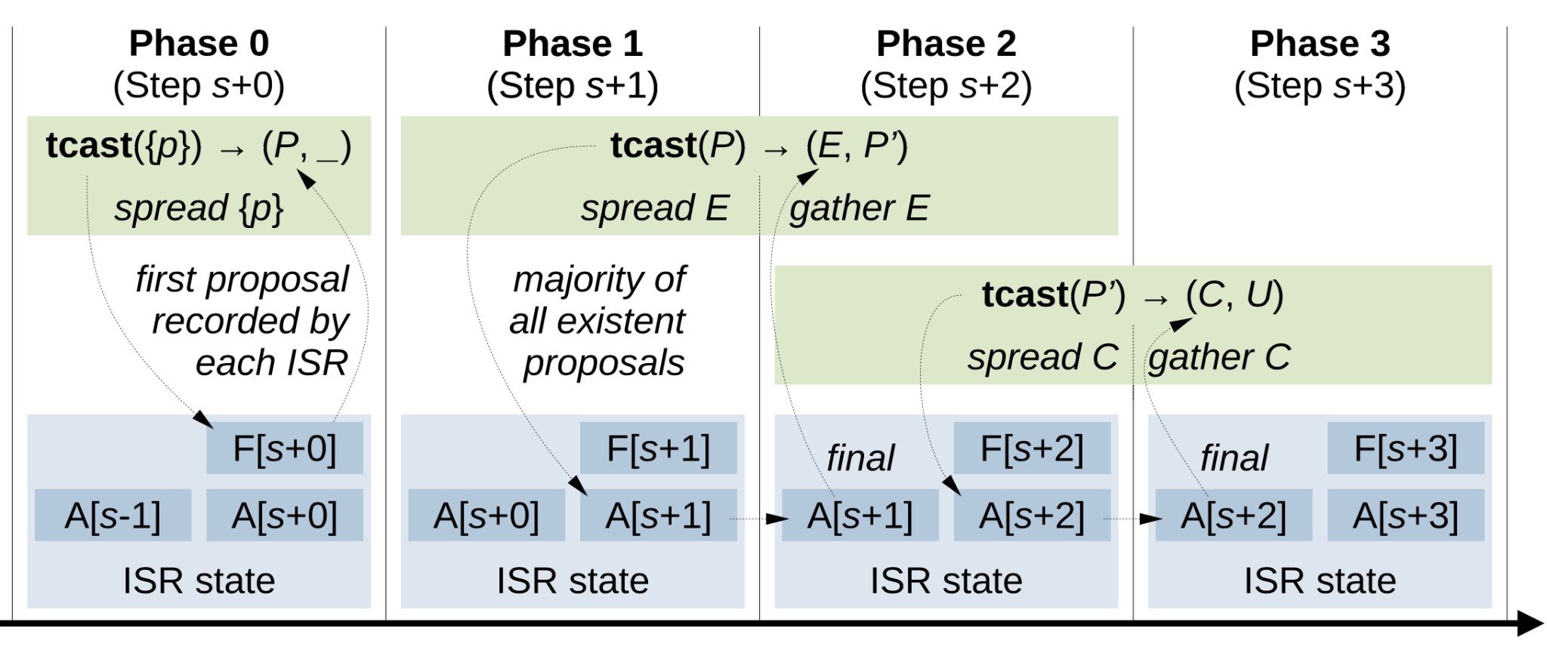
Correspondence between concrete and abstract QuePaxa (1)

Slide 64
Correspondence between concrete and abstract QuePaxa (2)
Concrete QuePaxa phase 0
Computes 𝑝 = best(𝑃); in abstract QuePaxa 𝑃 is the output set of the first tcast
Concrete QuePaxa phases 1 and 2
Computes 𝑎 = best(𝐸); in abstract QuePaxa 𝐸 is the first output of the second tcast
Computes 𝑝 = best(𝑃’), in abstract QuePaxa 𝐸 𝑃’ is the second output set of the second tcast
Concrete QuePaxa phases 2 and 3
Computes 𝑎 = best(𝐶); in abstract QuePaxa 𝐶 is the first output of the third tcast
Computes 𝑝 = best(𝑈 ); in abstract QuePaxa 𝑈 is the second output set of the third tcast

